Slide 1
Python
Saravana

Slide 2
What is Python?
Python is a high-level, interpreted programming language known for its simplicity and readability. It's widely used in various fields, including data science, web development, machine learning, and automation.
History of Python
Created by Guido van Rossum in the late 1980s, Python was designed with a focus on code readability and efficiency. Its emphasis on simplicity and a large standard library contributed to its rapid growth and popularity.

Slide 3
Installing and Setting Up Python
Choosing a Python version:
Python has two major versions: Python 2 and Python 3. It's recommended to use Python 3 for new projects.
Downloading and installing:
Visit the official Python website (https://www.python.org/downloads/) and download the appropriate installer for your operating system (Windows, macOS, Linux).
Verifying the installation:
Open a terminal or command prompt and type python --version or python3 --version. You should see the installed Python version.

Slide 4
Installing Options
Installing Anaconda
Download: Visit the Anaconda website (https://www.anaconda.com/products/individual) and download the appropriate installer.
Google Colab
Cloud-based Jupyter Notebook: Welcome To Colab - Colab (google.com)
Installing PyCharm
Visit the PyCharm download page: https://www.jetbrains.com/pycharm/download/

Slide 5
Basic Syntax: Variables and Data Types
Variables:
A variable is a named container for storing data.
Use the assignment operator = to assign a value to a variable.
Variable names can contain letters, numbers, and underscores but cannot start with a number.

Slide 6
Data Types
Python is dynamically typed, meaning you don't need to declare the data type of a variable beforehand.
Common data types:
Integers: Whole numbers (e.g., 42, -10)
Floats: Numbers with decimal points (e.g., 3.14, 2.5)
Strings: Textual data (e.g., "Hello, world!", 'Python')
Booleans: True or False values

Slide 7
Operators
Operators are symbols used to perform operations on values or variables.
Arithmetic operators:
+ (addition)
- (subtraction)
* (multiplication)
/ (division)
% (modulo - remainder)
// (floor division)
** (exponentiation)

Slide 8
Comparison operators:
== (equal to)
!= (not equal to)
< (less than)
> (greater than)
<= (less than or equal to)
>= (greater than or equal to)

Slide 9
Logical operators
and (both conditions must be true)
or (at least one condition must be true)
not (negates a condition)

Slide 10
Exercise
Create variables to store your name, age, and whether you like Python.
Calculate the area of a rectangle with given length and width.
Check if a number is even or odd.

Slide 11
Variables, Keywords Statements and Comments
Variables: As discussed yesterday, variables are named containers for storing data. Python is dynamically typed, so you don't need to declare the data type beforehand.
Keywords: These are reserved words in Python that have special meanings and cannot be used as variable names. Examples include if, else, for, while, def, class, import, etc.
Statements: Instructions given to the Python interpreter. Each line of code is generally a statement.
Comments: Explanatory notes within the code. They are ignored by the interpreter.
Single-line comments: # This is a comment
Multi-line comments: """ This is a multi-line comment """

Slide 12
Indentation
Python uses whitespace indentation to define code blocks.
Consistent indentation is crucial for code readability and execution.
Incorrect indentation leads to IndentationError.
Input and Output
Input: Used to get user input.
Output: Used to display results or messages.

Slide 13
String Manipulation
Strings are sequences of characters.
Basic operations:
Concatenation: Combining strings using the + operator.
Indexing: Accessing individual characters using square brackets.
Slicing: Extracting a substring using [start:end].
Length: Finding the length of a string using len().

Slide 14
Operators
Arithmetic operators: +, -, *, /, %, //, **
Comparison operators: ==, !=, <, >, <=, >=
Assignment operators: =, +=, -=, *=, /=
Logical operators: and, or, not
Bitwise operators: &, |, ^, ~, <<, >> (used for bit-level operations)
Membership operators: in, not in (used to check if a value is present in a sequence)
Identity operators: is, is not (compare object identities)

Slide 15
Data Structures
Lists: Ordered collections of items.
Can contain elements of different data types.
Created using square brackets [].
Accessed using indexing and slicing.
Tuples: Ordered collections of items, similar to lists but immutable (cannot be changed after creation).
Created using parentheses ().

Slide 16
Data Structures
Dictionaries - Unordered collections of key-value pairs.
Keys must be unique and immutable (strings, numbers, or tuples).
Values can be of any data type.
Created using curly braces {}.
Accessed using keys.
Sets - Unordered collections of unique elements.
No duplicate elements allowed.
Used for mathematical set operations (union, intersection, difference).
Created using curly braces {} or the set() constructor.

Slide 17
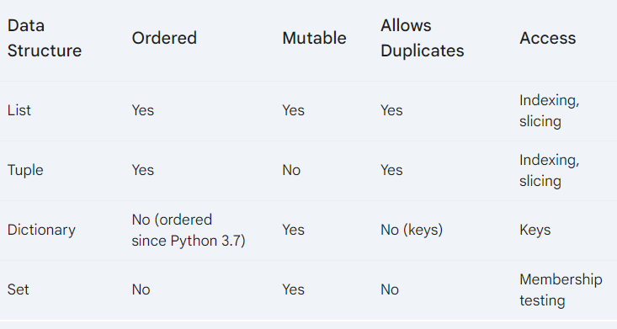
Key differences

Slide 18
Control Flow Statements
Control flow statements determine the order in which code is executed. They allow you to make decisions and repeat actions based on conditions.
If-Else Statements
Used to make decisions based on conditions.
Loops
Used to repeat a block of code multiple times.
For Loops
Iterate over a sequence (list, tuple, string, etc.).
While Loops
Execute a block of code as long as a condition is true.

Slide 19
Control Flow Statements
Nested Loops
Loops within loops - Used for tasks involving multiple iterations.
Break and Continue
Break: Terminates the loop entirely.
Continue: Skips the current iteration and moves to the next.

Slide 20
Exercise:
Write a program to check if a number is even or odd.
Create a program to print the multiplication table of a given number.
Find the factorial of a number using a loop.
Write a program to find the largest number in a list.

Slide 21
Understanding Functions
A function is a reusable block of code that performs a specific task. It helps to organize code, improve readability, and promote code reusability.
Defining Functions
Use the def keyword followed by the function name and parentheses.
Optionally, include parameters within the parentheses.
The function body is indented.
Use the return statement to specify the output.

Slide 22
Understanding Functions
Functions without parameters: Don't require any input values.
Functions with parameters: Accept input values.
Local and Global Variables
Local variables: Defined within a function and accessible only within that function.
Global variables: Defined outside of any function and accessible from anywhere in the program.
Lambda Functions
Anonymous functions defined using the lambda keyword.
Used for short, simple functions.

Slide 23
Understanding Functions
Calling Functions, Parameters, and Return Values
To call a function, use its name followed by parentheses.
Pass arguments (values) to the function through parameters.
A function can return a value using the return statement.

Slide 24
List Comprehension
A concise way to create lists based on existing lists or other iterable objects.
numbers = [1, 2, 3, 4, 5]
squares = [x**2 for x in numbers]
print(squares) # Output: [1, 4, 9, 16, 25]

Slide 25
Exercise
Write a function to calculate the factorial of a number.
Create a function to check if a number is prime.
Use list comprehension to create a list of even numbers from 1 to 20.
Write a lambda function to square a number.

Slide 26
Thanks

